Slide 1
Data Retrieval
By Ravi Shende

Slide 2
Information Layout
There are 3 main data types for everything that is being retrieved:
Data Points (Header vales - top 4 data points seen in Grafana)
Tables
Graphs
Currently, all data is collected using PromQL, then represented in Pandas DataFrames, with each data frame containing values split up by Node and Pod.

Slide 3
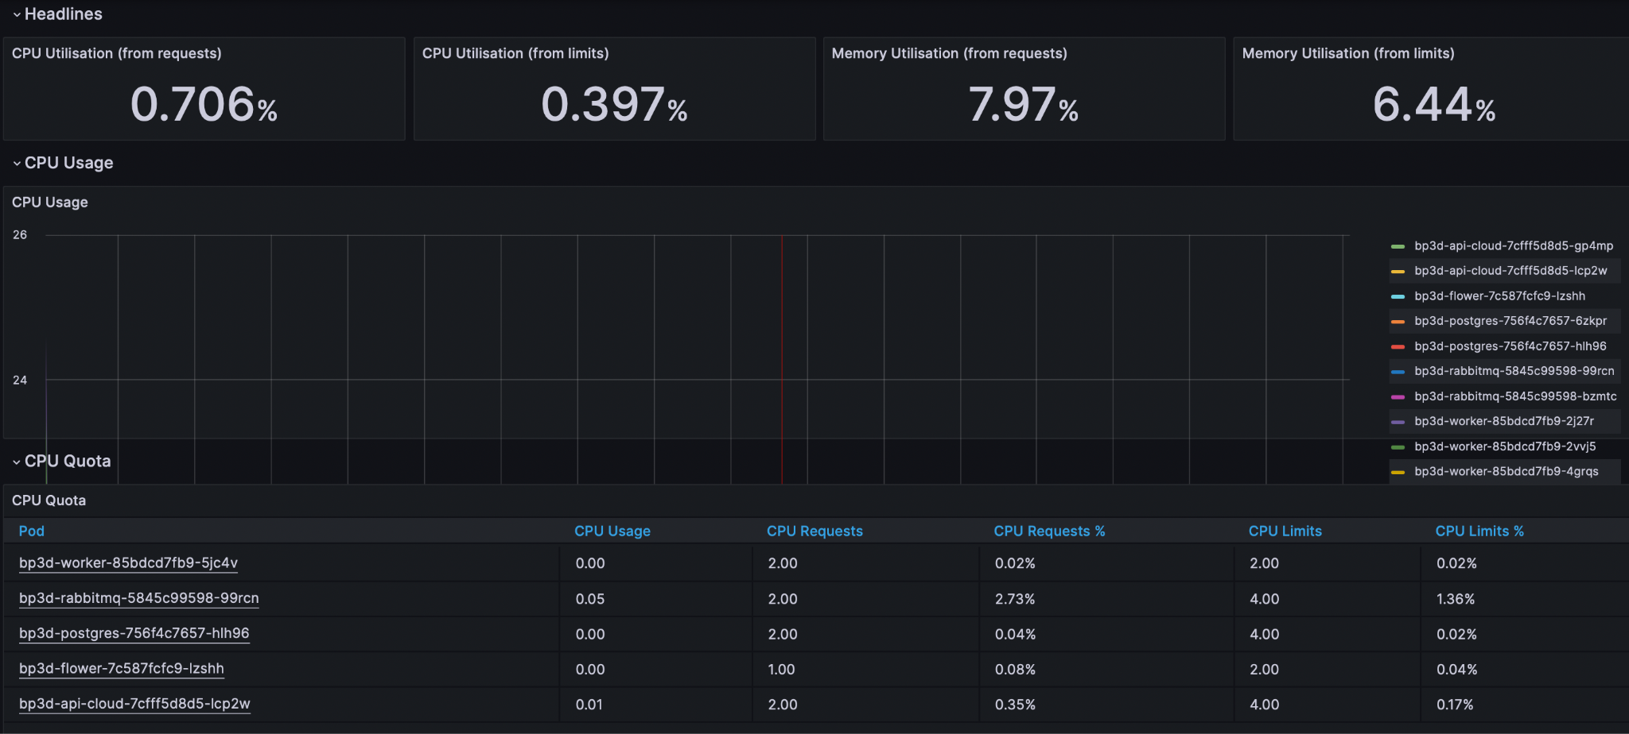
What is Being Collected
All the data being collected currently is based on the main information categories displayed by Grafana.
Any information collected by the site can also be collected by the program.
To the left, there is shown a portion of the information displayed on grafana.

Slide 4
Inputs
There are 3 main inputs that specify what information will be returned
Duration (Used by all 3 data types)
For header values, specifies the time frame to check for data. If there is data, it is only calculated based on the 2 most recent data points.
For Tables, specifies the time everything is summed across.
For graphs, specifies the Δx for which data point values are calculated
Graph Step
How often data points are collected along an interval; resolution
Graph Time Offset
How far back from the end point to collect data from.
Default endpoint is current time but can be specified to any time when initializing the graphs class.
There are other inputs that can be specified (such as namespace), but these are the most useful

Slide 5
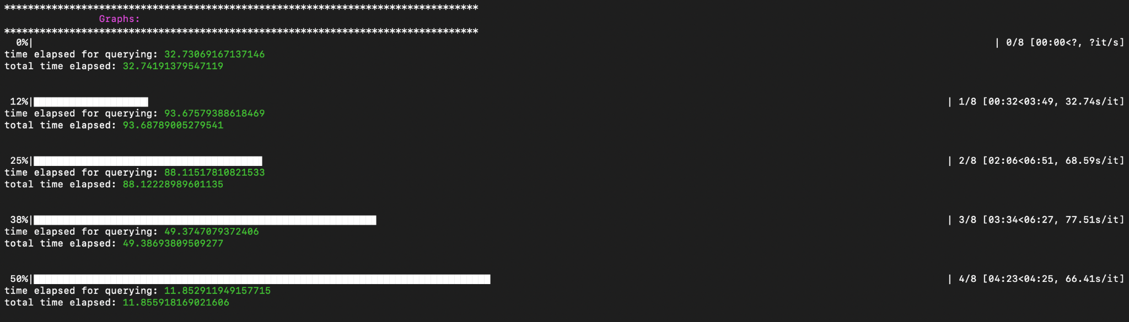
Run Times
Currently the Header values and Tables are all collected quite quickly, within a matter of a few seconds. Graphs take much longer to query data for, taking dozens of seconds to minutes depending on the input parameters (mainly step and time offset).
In terms of code efficiency, the bottleneck is by far querying the api. Once that is done, all calculations, reformatting, and printing happen within hundredths of a second. There is not much that can be done about the time of queries.
The picture to the left shows the process of waiting while collecting graph data before it is all displayed

Slide 6
Data Being Collected
Per Data Type

Slide 7
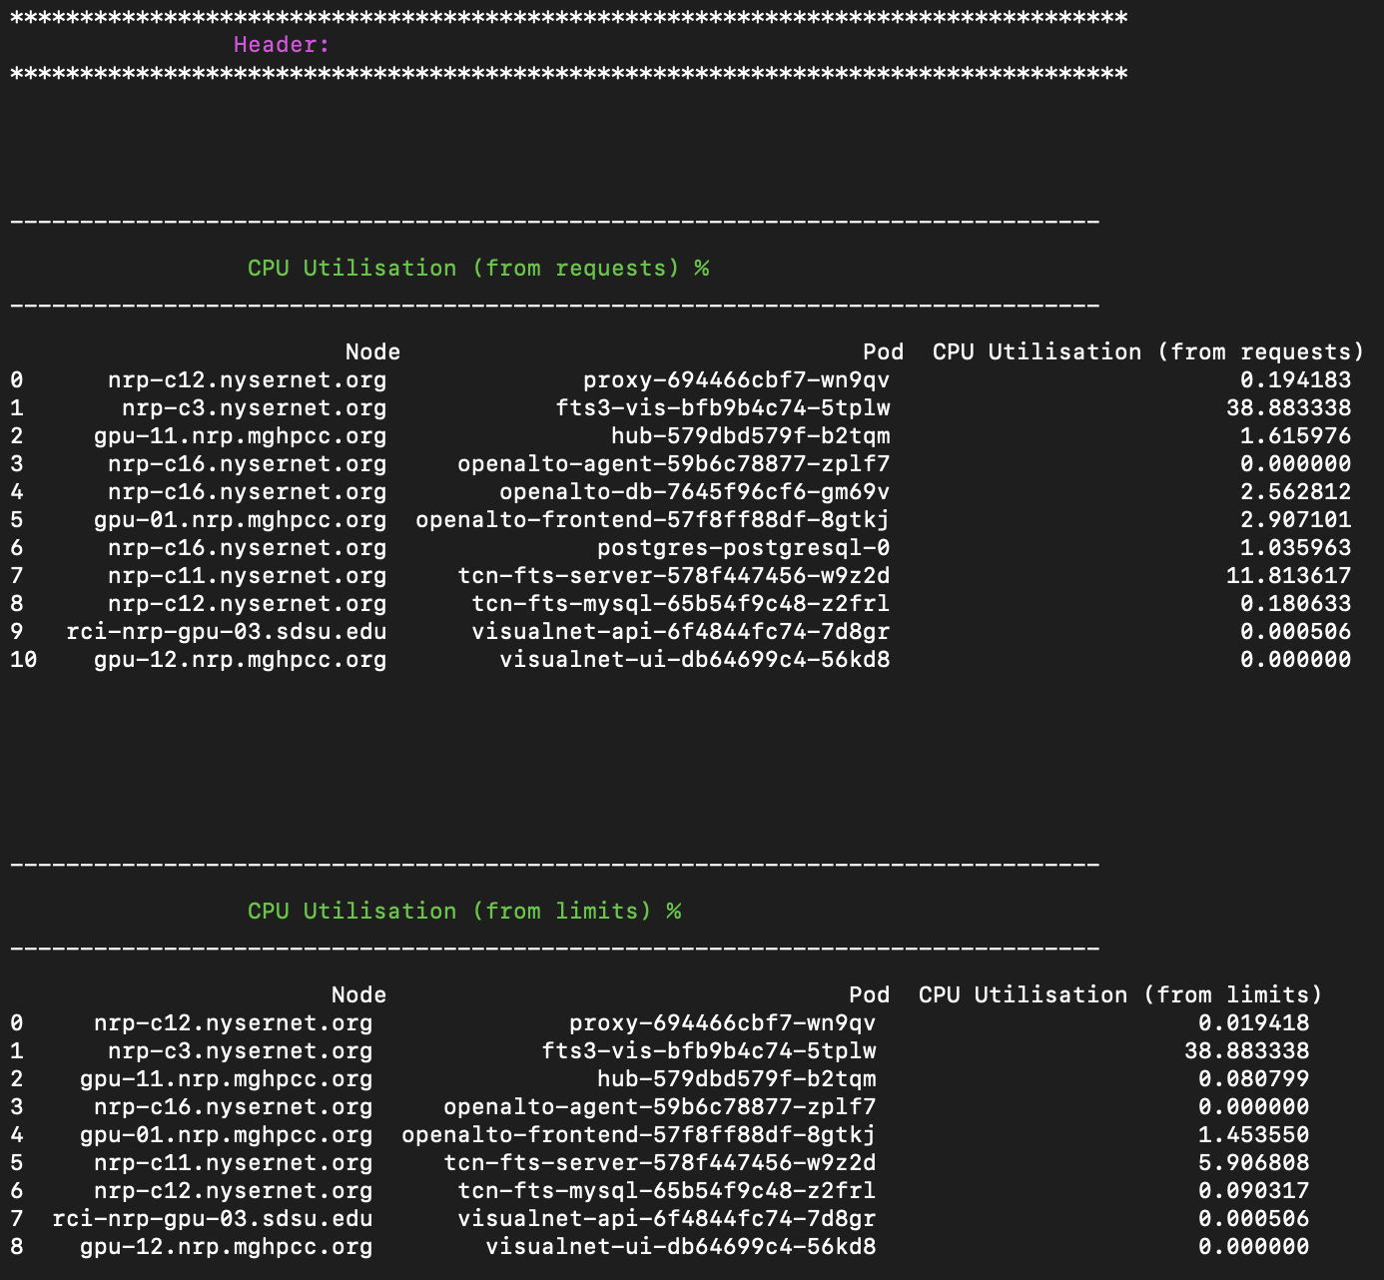
Header Values
CPU Utilization % (from requests)
CPU Utilization % (from limits)
Memory Utilization % (from requests)
Memory Utilization % (from limits)
To the right, you can see the data frames containing the information for the first 2 header categories by node and pod.

Slide 8
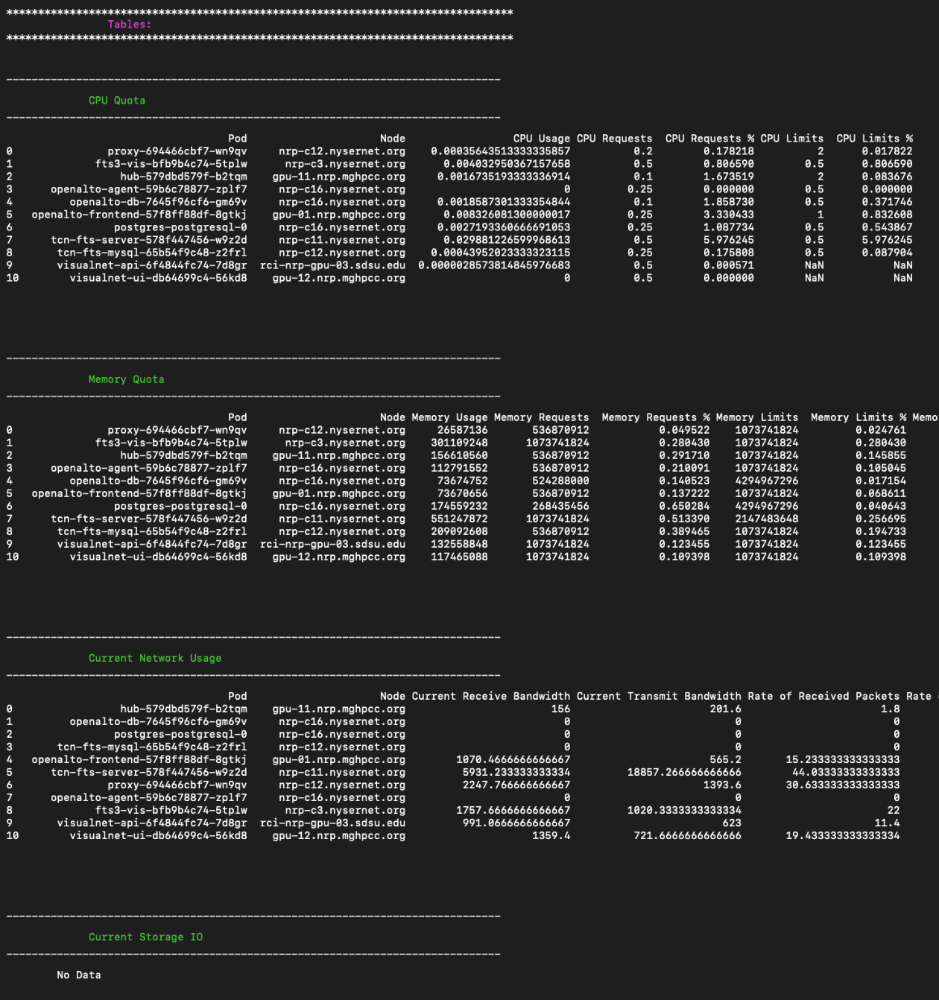
Tables
CPU Quota:
CPU Usage
CPU Requests
CPU Requests %
CPU Limits
CPU Limits %
Memory Quota
Memory Usage
Memory Requests
Memory Requests %
Memory Limits
Memory Limits %
Memory Usage (RSS)
Memory Usage (Cache)
Current Network Usage
Current Receive Bandwidth
Current Transmit Bandwidth
Rate of Received Packets
Rate of Transmitted Packets
Rate of Received Packets Dropped
Rate of Transmitted Packets Dropped
Current Storage IO
IOPS(Reads)
IOPS(Writes)
IOPS(Reads + Writes)
Throughput(Read)
Throughput(Write)
Throughput(Read + Write)

Slide 9
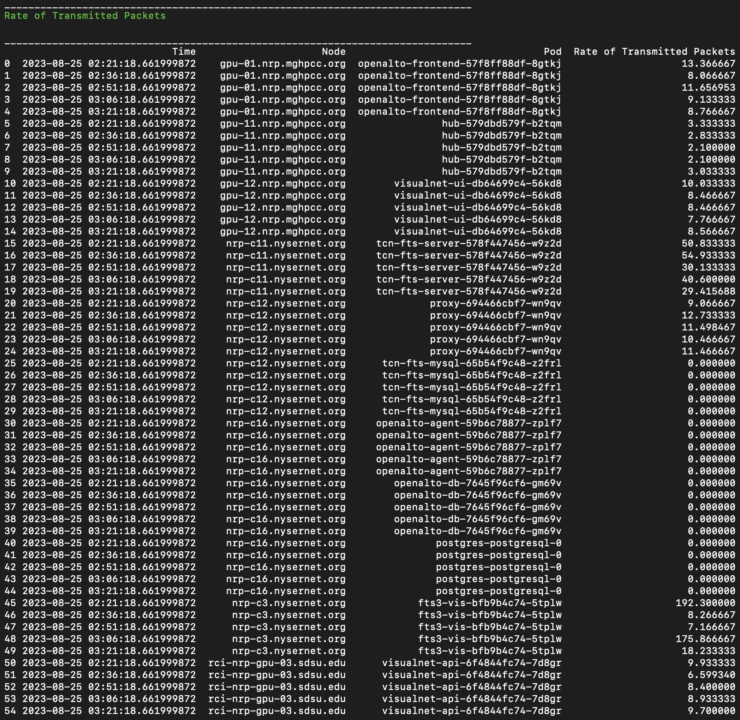
Graphs
CPU Usage
Memory Usage
Receive Bandwidth
Transmit Bandwidth
Rate of Received Packets
Rate of Transmitted Packets
Rate of Received Packets Dropped
Rate of Transmitted Packets Dropped
IOPS(Read+Write)
ThroughPut(Read+Write)
The above picture shows the data frame for the graph Rate of Transmitted Packets. Note for each node and pod, there are data points for different times. Each pod would represent a different colored line on a graph.

Slide 10
Future Direction
With everything in pandas data frames, it shouldn’t prove too challenging to integrate this data with any database we like.
If we choose to go with a time based database like InfluxDB, it will be simple to include timestamps for headers and tables, as they are already being collected by the queries, just not displayed.
For additional enhancements, I am planning on looking into adding the ability to access node temperature for each node. Furthermore, I plan to introduce the feature to look for any unexpected drops in graph data and to be able to tell when those are and on which nodes and pods they occur.

